Slide 1

League of Legends Player Analytics

Slide 2
Questions posed
Who has the better kill/death ratio between two people?
Can data from one champion show which of the two people play better?
Are the overall stats of every champion played over the year available?

Slide 3
Brief League of Legends background
In game stats – Kills/Deaths/Assists
Objective of the game
Where the postgame data is obtained

Slide 4
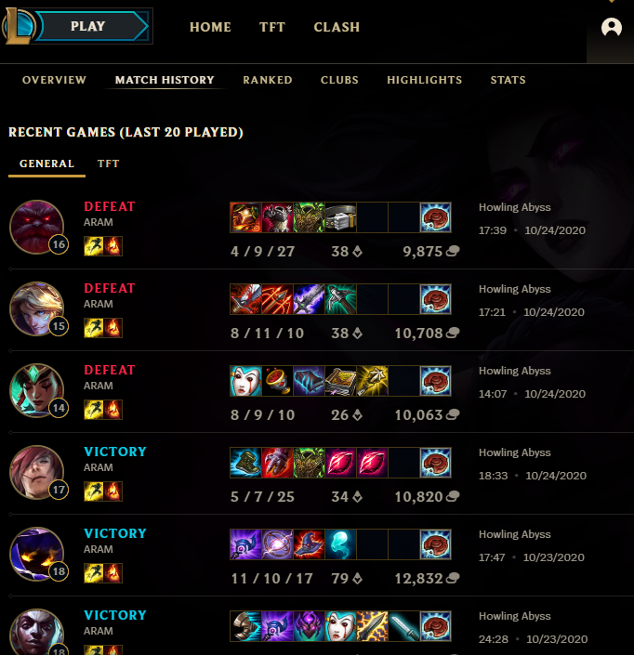
Initial data
Initial data was a set of 20
Used this mini set prior to dealing with the larger set

Slide 5
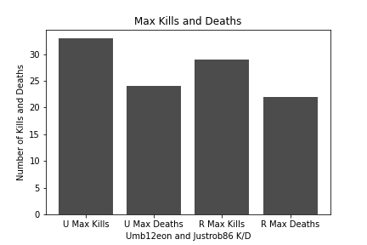
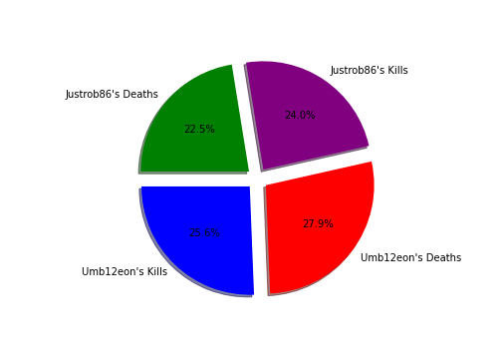
Who has a better Kill/Death Ratio?
Using one champion’s data for both
Data shows who gains more kills and deaths

Slide 6
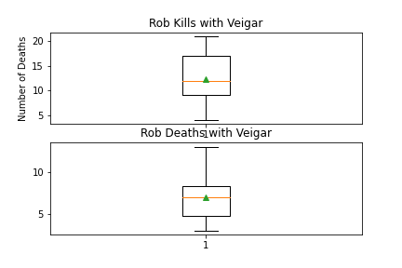
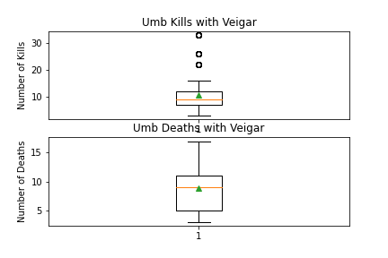
One champion…Who is better?
Box plots to best show stats
Major outliers
Box plots show Umb12eon is equally bad/good with the champion

Slide 7
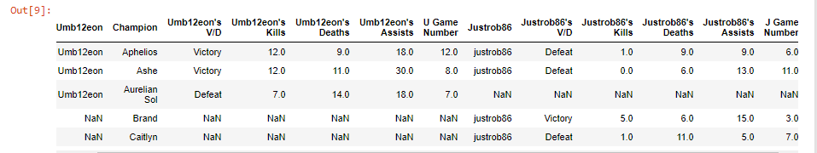
Table of the data
What the table represents/contains

Slide 8

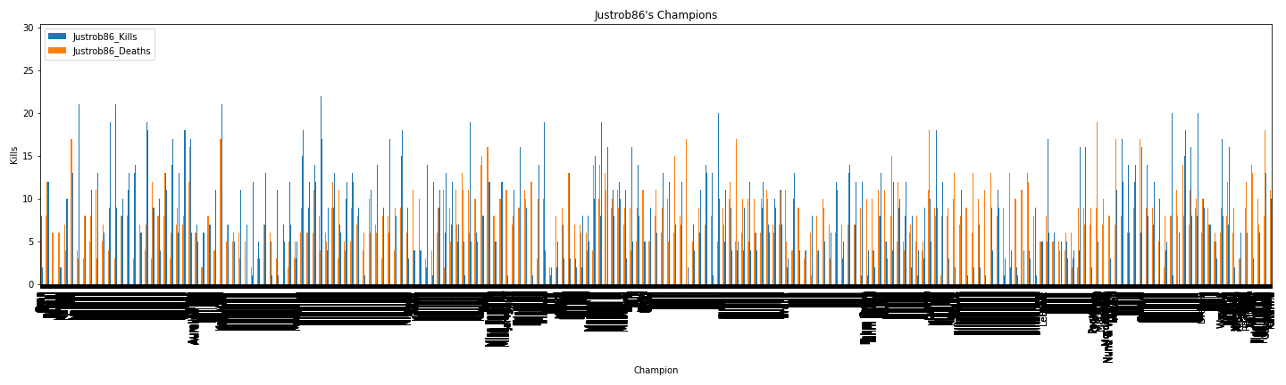
Overall Stats of All Justrob86’s Champions

Slide 9
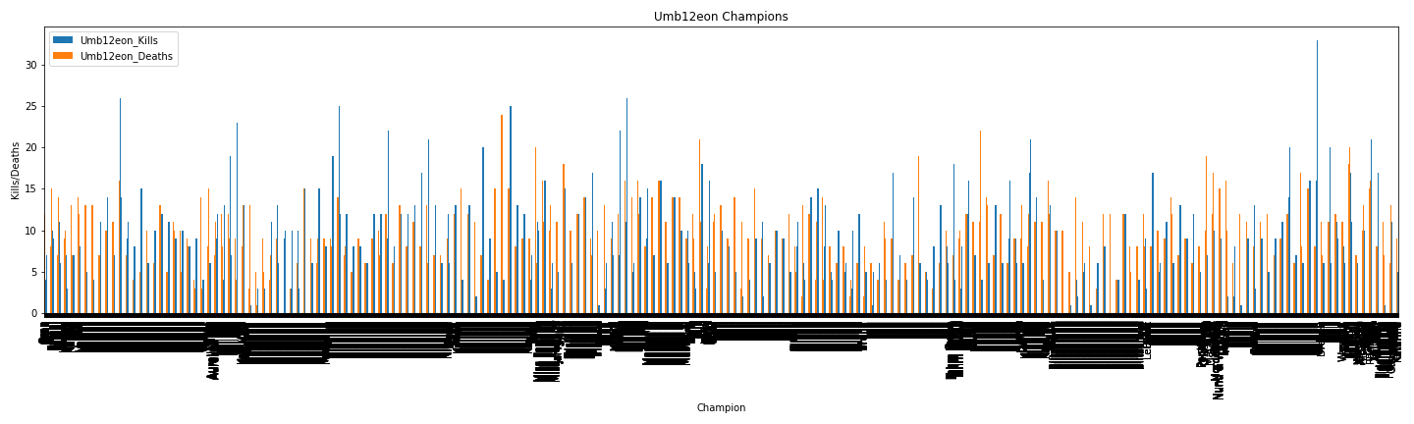
Overall Stats of All Umb12eon’s Champions

Slide 10
Conclusions
Justrob86 is a better player than Umb12eon(me)
Even with horrible stats, I still want to continue playing

